Slide 1
Lending Club Case Study Overview
Case Study Group Members
- Anu Shrinidhi
- Shilpa Mathad

Slide 2
Lending Club Case Study – Business Understanding
Consumer finance company is specialized in lending various types of loans to customers. Based on applicant profile, company decides to take below actions. Based on which risks involved are,
Applicant who is likely to repay the loan
If profile not validated correctly, its going to be a loss of business for consumer finance company
Applicant who is not likely to repay the loan
If profile not validated correctly, approving the loan might lead to financial loss for the consumer finance company
The loan data set provided contains details about past loan applicants. It has various attributes related to consumer attributes,
Loan attributes
Applicant profile information including details like their employment details and income etc.
Consumer attributes
There are two possible decisions from the loan data set analysis.
Accept Loan Application
The defaulters or non defaulters are going to be identified from this given data set.
There are 3 possible scenarios on the accepted applicants.
Fully Paid – Loan is fully paid by customers
Current – The loan is being paid on time in terms of installment by customers and its still having a active loan but not going to default.
Charged Off – The customer has not paid the installments for a long period of time.
Reject Loan Application
Not considered in our data set as the loan is rejected, it will not even come to the transaction data history.

Slide 3
Lending Case Club Study – Problem Statement
The objective is to conduct analysis on loan data set to identify driving factors that plays major role in identifying defaulters, so that at the time of loan application, we can use those variables for approval/rejection of the loan to derive conclusions.

Slide 4
Lending Case Club Study – Exploratory Data Analysis
Exploratory Data Analysis for loan data set will be conducted by performing below steps.
Data Cleaning – Data cleaning will be performed to have more meaningful and required data for our analysis.
Removing null/Nan/Blank value columns.
Analyze the column variables with null value percentage and eliminate those by doing a cleanup of those rows.
Drop the column variables which are not going to add value for our analysis.
Data Understanding
Get an understanding of the loan data set by going through data dictionary and the variables specific usage to see if they are going to contribute for our analysis
Univariate Analysis
Analysis each column to get their data pattern and business understanding by plotting the graphs to read the distribution
Bivariate Analysis
Analyze the two data variables to see if we can get a meaningful insight of those variables
Segmented Univariate Analysis
Analyzing the continuous data variables with respect to the categorical column
Conclusion – Solution recommendations
Provide final conclusion to the problem statement based on finaly analysis.

Slide 5
EDA - Data Cleaning – Loan Data Set
Data cleaning activity is conducted for below criteria's in our analysis.
Analyzed the columns having missing values as Nan and marked those column values as True/False for reviewing the data
Identify the number of missing values by checking the sum of null values for each column to look for if there are any
Calculate the percentage of null values in each column for further understanding the data
Fetch the number of columns that have null values. The result indicates, there are 68 columns with null values
Dropped all the columns having all of its values as null
By looking at the XLS and the loan dataset here, it indicates that there are some columns which are not required for the loan defaulting approval process. The columns which are populated post loan processing will be removed as our focus is to identify defaulters for the upcoming loan processing. Below are the columns dropped as part of this activity.
url/desc/zip_code/addr_state/id/member_id/last_credit_pull_d/out_prncp_inv/total_pymnt_inv/delinq_2yrs/revol_bal/out_prncp/total_pymnt/total_rec_prncp/total_rec_int/total_rec_late_fee/recoveries/collection_recovery_fee/last_pymnt_d/last_pymnt_amnt/chargeoff_within_12_mths
The below listed columns specified don't have more than one value which can contribute to our analysis. So removing these columns
pymnt_plan --> n/initial_list_status --> f/collections_12_mths_ex_med --> 0/policy_code --> 1/acc_now_delinq --> 0/application_type/INDIVIDUAL/pub_rec_bankruptcies --> 0/tax_liens --> 0/delinq_amnt --> 0
Now, The final list of column variables retained are useful columns for our analysis which are filtered post missing value/unwanted columns/Single value columns cleanup activity

Slide 6
EDA - Data Understanding – Loan Data Set
Get an understanding of the loan data set by going through data dictionary and the variables specific usage to see if they are going to contribute for our analysis.
Eliminate columns which has about 80% of data with missing values and eliminate those
Removing the percentage symbol by retaining their values for analysis from percentage values related to below listed columns¶
1. int_rate
2. revol_until
Removing the percentage symbol from int_Rate column
Dropping null columns for revol_util
Remove the percentage from revol_util column values to use for analysis
Remove the percentage from int_rate column values to use for analysis
The employee length column is having values with + and < and > values. Remove all these and retain numeric value for this column. Years string also needs to be trimmed from the employee length.

Slide 7
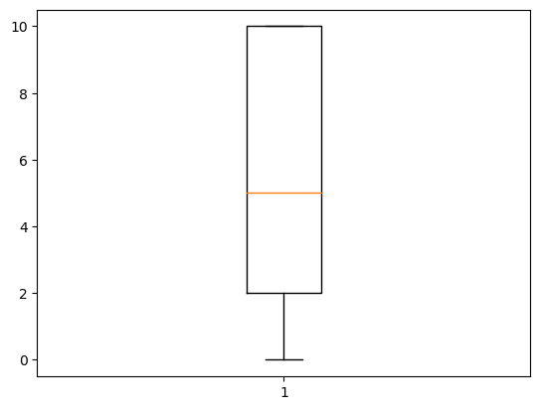
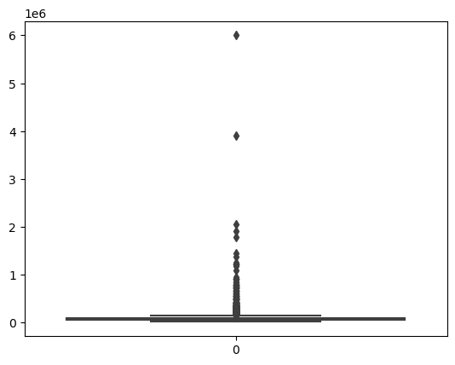
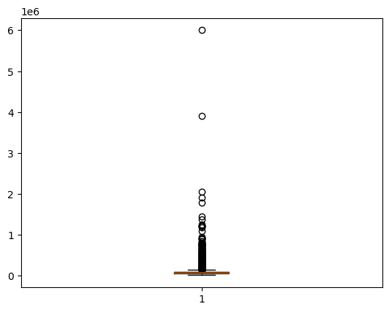
Outlier Treatment – Loan Data Set
Finding percentage of null or missing values remaining and printing columns which have more than 0% missing values¶
No outliers for emp_length
Handling outliers by drawing a box plot for annual income as well
The annual_inc is having outliers and observe the outliers with quantile percentage and observe that there are outliers for annual_inc more than 95%. Cleanup the values greater than 95% of annual_inc.
Handling outliers by drawing a box plot for loan amount

Slide 8
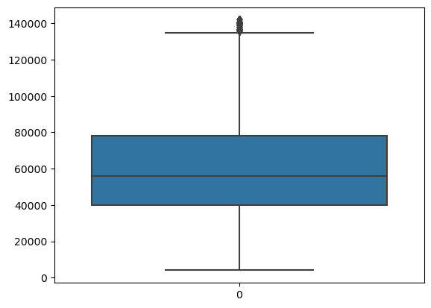
Outlier Treatment – Loan Data Set cont..
The outliers are removed for annual_inc greater than 95%. The boxplot below depicts reduced outliers

Slide 9
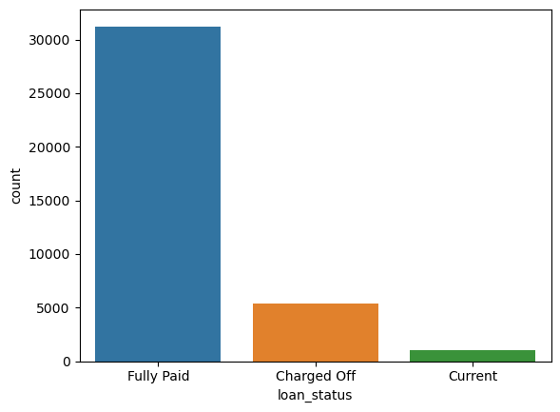
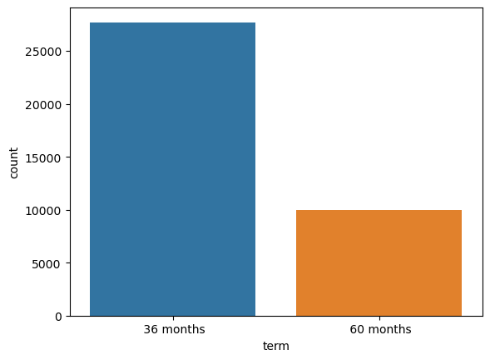
Univariate Analysis
Univariate Analysis - Loan Status
Majority of the borrowers have paid off their loan fully but still there are certain borrowers who's loans are charged off. Charged off borrowers are not able to pay but still liable to the bank. Charged off are going to fall under defaulter category.
Univariate Analysis - Term
Shorter the period the number of borrowers are more. The borrower could be a defaulter if the term is lesser and also the term here may represent upcoming loan application related term or the processed loan term. So not able to conclude analysis on this data frame column - term

Slide 10
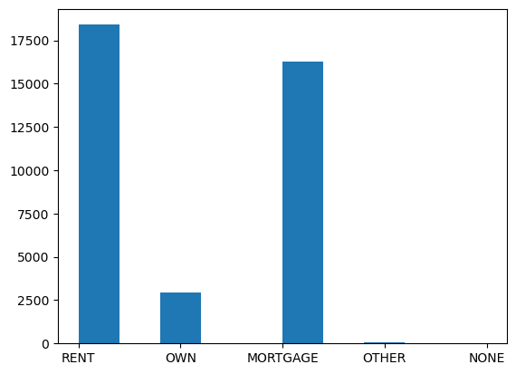
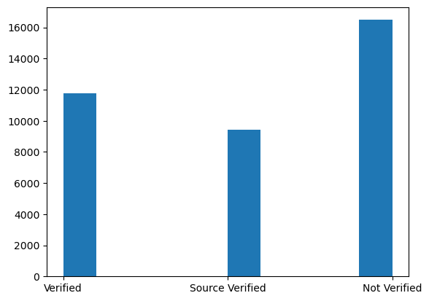
Univariate Analysis cont..
Univariate Analysis - verification_status
The below graph indicates,
Majority of the loan borrowers income is not verified and they could be prone to defaulting.
Approximately around 20-25% of the borrowers income source was verified but not the income. There is a small percentage of risk that these borrowers can become defaulters.
The verified borrowers are completely out of risk for defaulting process.
Univariate Variable - home_ownership
There are more loan borrowers who are in rented property and the mortgage implies that they already have an active loan. Overall it looks like, people with own house are buying less % of loan.

Slide 11
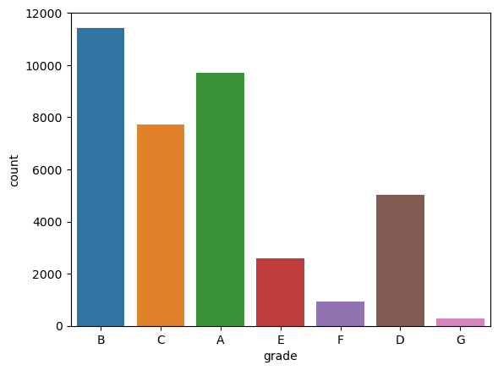
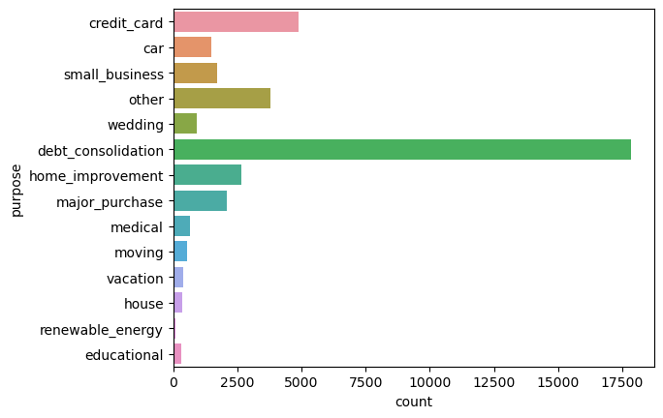
Univariate Analysis cont..
Univariate Analysis - Purpose
Univariate Variable - Grade
There are higher number of loan borrowers as part of grade A & B. Further, the loan borrowers decreases as the grade decreases.
Debt consolidation related loan borrowers are more.

Slide 12
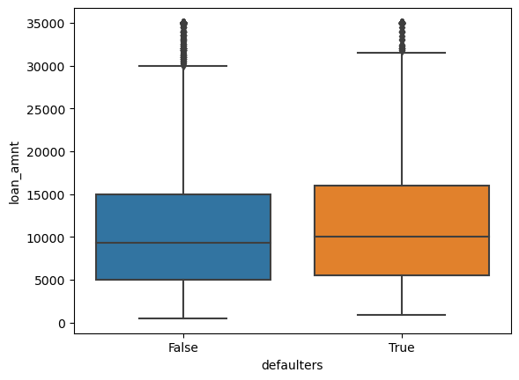
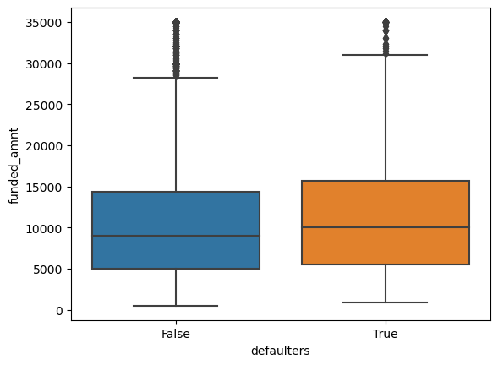
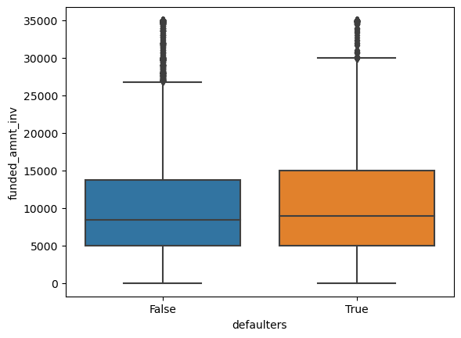
Bivariate Analysis
Bivariate Analysis - loan_amount/funded_amnt/funded_amnt_inv - Boxplots are used for conducting bivariate analysis for the loan_amount/funded_amnt/funded_amnt_inv/annual_inc/revol_rate/int_rate
Identify defaulters - As a first step, The defaulters are with loan_status as charged off are filtered for our bivariate analysis. After this we are conducting the bivariate analysis on the latest data set.
Identify defaulters based on
loan_amount
funded_amnt
funded_amnt_inv issued by bank department
The defaulters and the non defaulters for the above amount fields appears to have a very small difference which is not deriving any sort of conclusion on these amount fields. As the amount proposed/funded by the bank for every borrower or customer appears to be the same. This is why it is implying a very small negligible difference in loan_amount/funded_amnt/funded_amnt_inv at the 75th quantile

Slide 13
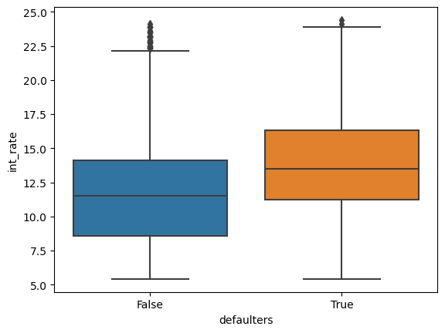
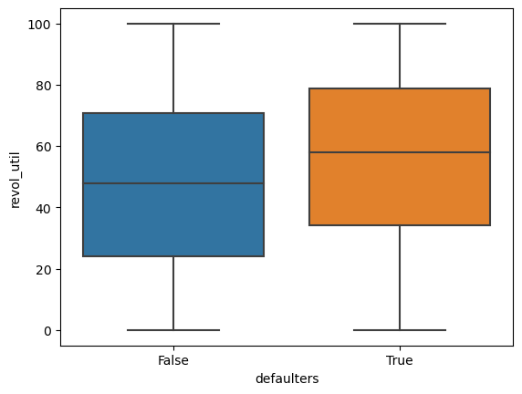
Bivariate Analysis
Bivariate analysis - int_rate
As the interest increases the number of defaulters increase. The bank should consider interest rate minimal like the non defaulters while considering loan application processing and this should reduce the number of defaulters.
Bivariate Analysis - revol_util
The revolving utilization rate is higher for defaulters based on the high usage of revolving credit.

Slide 14
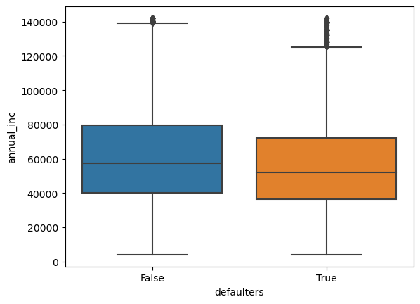
Bivariate Analysis cont.…
Bivariate Analysis - annual_inc
As the annual income of the borrower is higher less chances of becoming defaulter. The defaulters are higher with less annual income

Slide 15
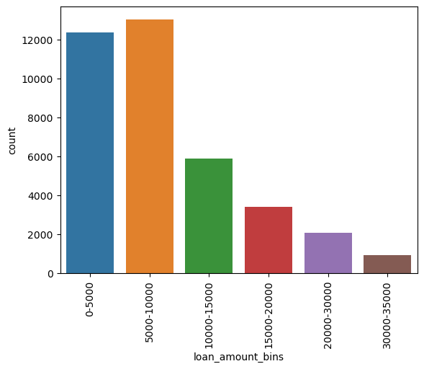
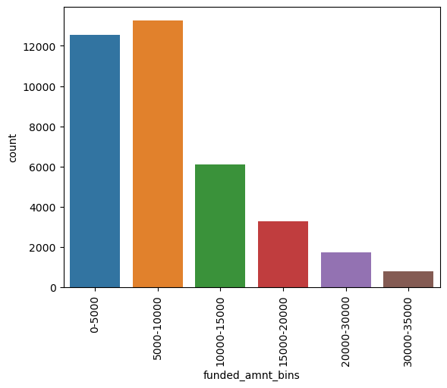
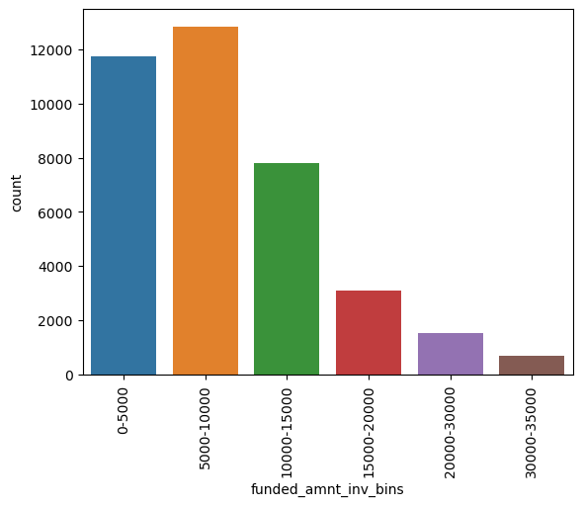
Segmented Univariate Analysis
We have used count plots for our analysis
Creating bins for the range for certain columns and trying to analyze in which range the defaulter are high for certain columns
Loan_amnt/funded_amnt/funded_amnt_inv Analysis
The borrowers with mean value and the 50th percentile of the loan amount, the defaulters are high. As the loan amount increases, the defaulters are less.
The bivariate analysis also indicates the similar trend from below graph.
The loan_amnt/funded_amnt/funded_amnt_inv_bins are created below and they all have a common trend as the loan_amnt/funded_amnt/funded_amnt_inv are high there are less defaulters. As the loan amount decreases, the defaulters high. It is also observed that, the loan_amnt/funded_amnt/funded_amnt_inv below 10000 has the highest defaulters and exceeding 10000 has the lowest trend.

Slide 16
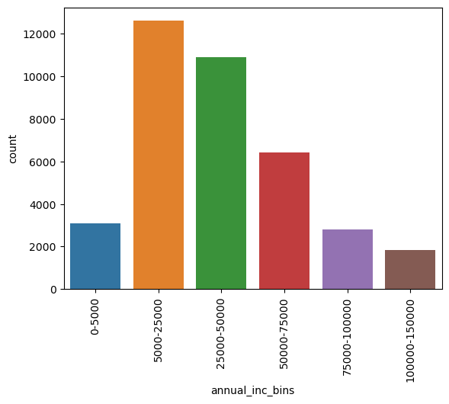
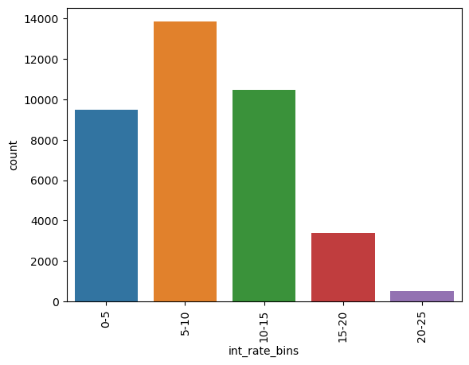
Segmented Univariate Analysis
annual_inc Analysis
int_rate Analysis
The borrowers with mean value and the 50th percentile of the loan amount, the defaulters are high. As the loan amount increases, the defaulters are less.
The bivariate analysis also indicates the similar trend from below graph. count 37695.000000
There are more defaulters with loan interest rate in the range 5-15%. Higher the interest rate, the tendency to close/pay the loan is higher
The defaulters are more when the salary range is below 50000. The defaulters are less with increased salary range of borrowers.

Slide 17
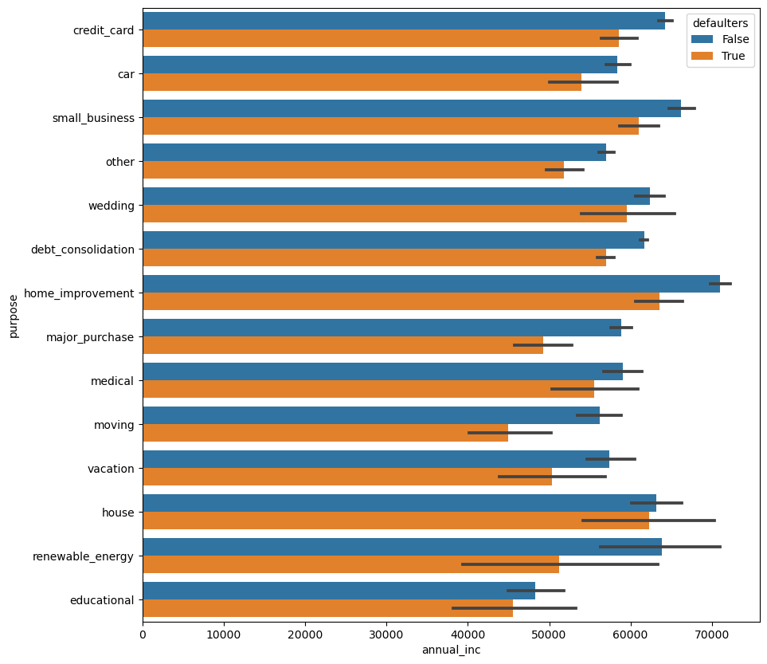
Bivariate Analysis - Using Bar plots
Annual_inc v/s purpose Analysis
The defaulters trend is observed with every salary range of annual income but their purpose of loan categories are deviating for different range of annual_inc
The defaulters are more with annual_inc greater than 50000 in loan borrowers categories like
home improvement/small business/house/medical/credit card/wedding/debt consolidation
The defaulters are more with annual_inc less than 50000 in loan borrowers categories like
Car/other/major purpose/moving/vacation/education/renewable energy
Irrespective of the annual_inc and purpose of loan applied by borrower, the defaulting risk is high in every purpose and with every annual_inc range.

Slide 18
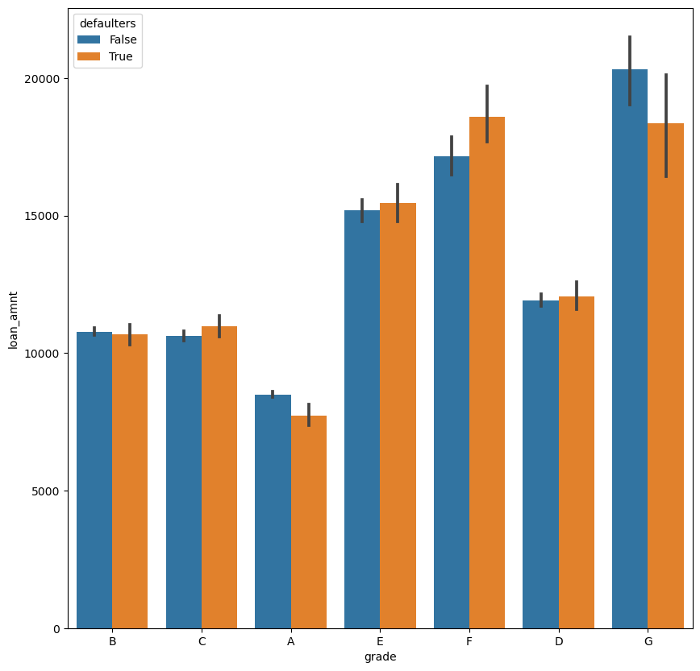
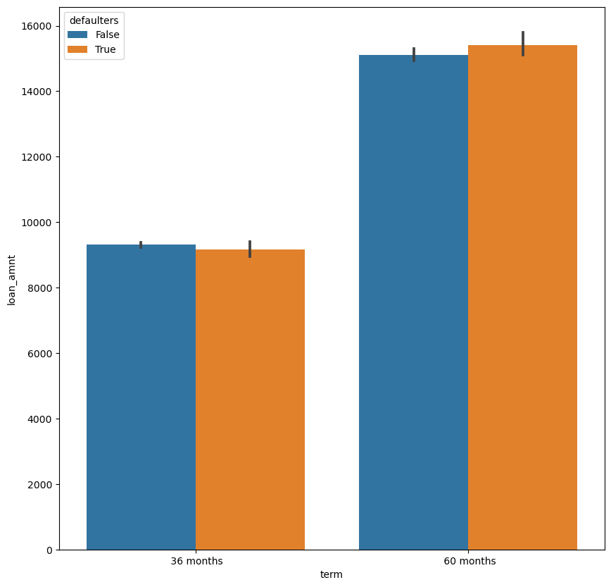
Bivariate Analysis - Grade v/s loan_amnt & Loan_amnt v/s Term
Loan_amnt v/s Term
Grade v/s loan_amnt
The grades with E, F and G are having more defaulters for the loan amount greater than 10000. The grade A, B, C & D are having less defaulters with loan less than 10000. Any loan amount will have the risk of defaulters irrespective of the grade and the loan amount.
The borrowers with less loan term are having less defaulters with the loan amount below 10000. As the term is high, the defaulters are more with the increased loan amount trend. The defaulters are anyways high irrespective of term and also the loan amount.

Slide 19
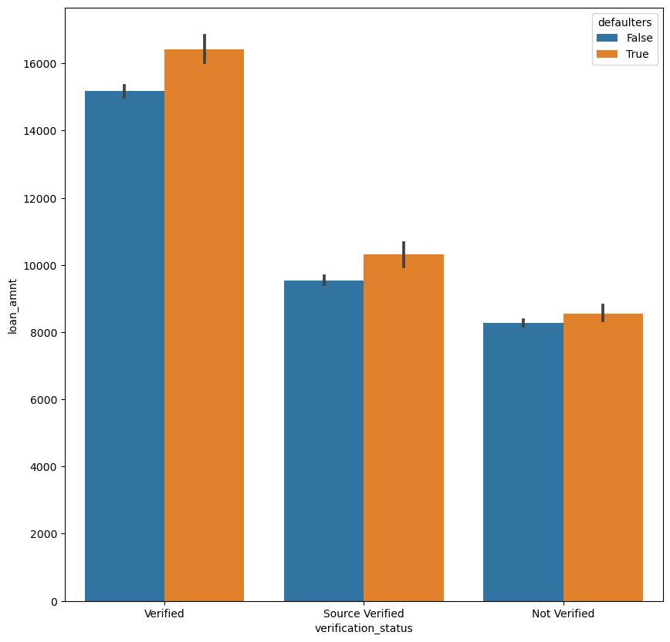
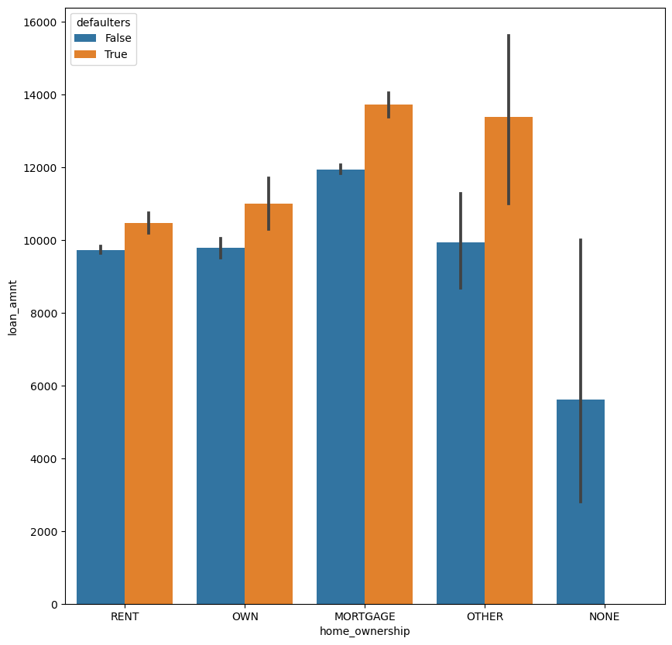
Bivariate Analysis - loan_amnt/Verification_status Analysis and Loan_amnt v/s Home Ownership Analysis
Loan_amnt v/s Home Ownership Analysis
loan_amnt/Verification_status Analysis
The defaulters are identified in every category of the verification_status with verified/source verified/not verified. However, its good idea to reduce the loan_amnt as the defaulting risk is high irrespective of the verification_status
The defaulters are high in every home ownership category. However, The home ownership with mortgage and other categories are having very high defaulters trend. The own and rent home ownership categories are having comparatively less defaulters. Its better to consider the own and rent home categories with a lesser loan amount to reduce the defaulters risk. The mortgage home ownership is having higher loan amount and the high defaulters so, reducing the loan_amnt might reduce the risk of defaulters.

Slide 20
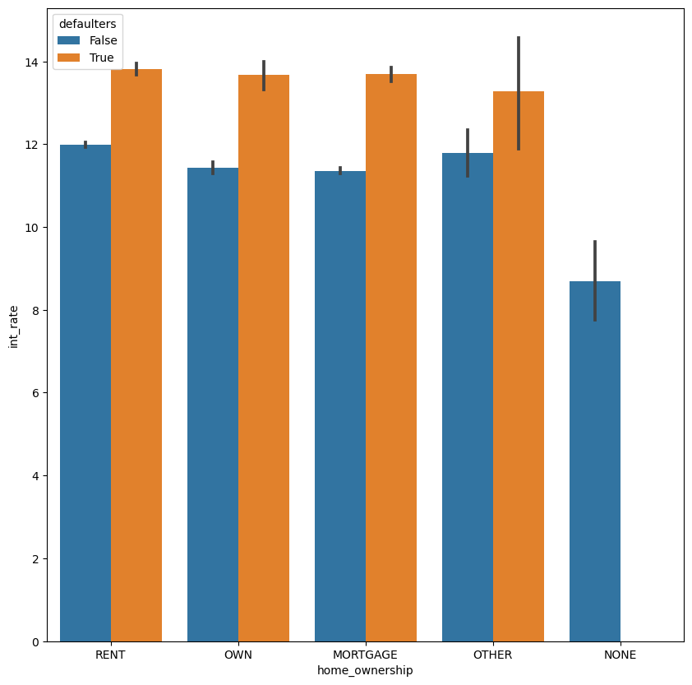
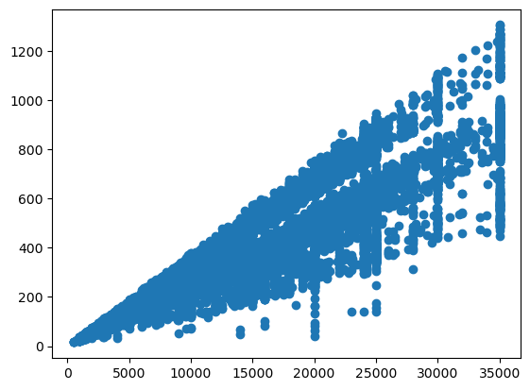
Bivariate Analysis - Int_Rate v/s Home Ownership Analysis and Loan_amnt v/s installments – scatter plot
Int_Rate v/s Home Ownership Analysis
As the interest goes high, the defaulters are high in every home ownership category
Scatter Plots - loan_amnt v/s installments
As the number of installments increases along with loan amount, there is a high risk of defaulters. With less installments and the less loan amount, we can see there is a positive correlation between the loan amount and installments.

Slide 21
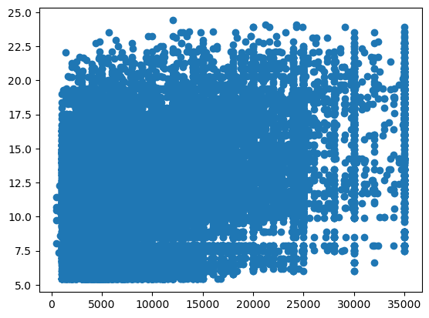
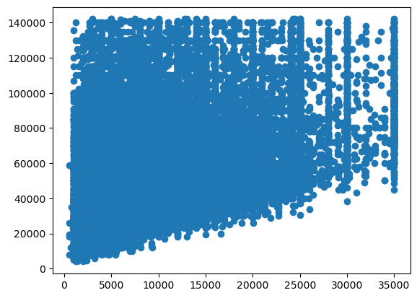
Scatter plots - loan_amnt v/s annual_inc and loan_amnt v/s int_rate
Scatter plot - loan_amnt v/s annual_inc
Higher the annual income with lower loan amount, the defaulters are less as in the loan_amount below 20000 and the annual_inc around 100000 there are less defaulters. To reduce the defaulters risk, the loan amount approved for higher income borrowers can be little lower loan amount than the maximum suggested range today
Scatter plot - loan_amnt v/s int_rate
The defaulters risk is low with reduced interest rate along with reduced loan amount. The interest exceeding 17.5 % and loan amount exceeding 15000 is not showing a great correlation and it indicates higher risk of defaulters.

Slide 22
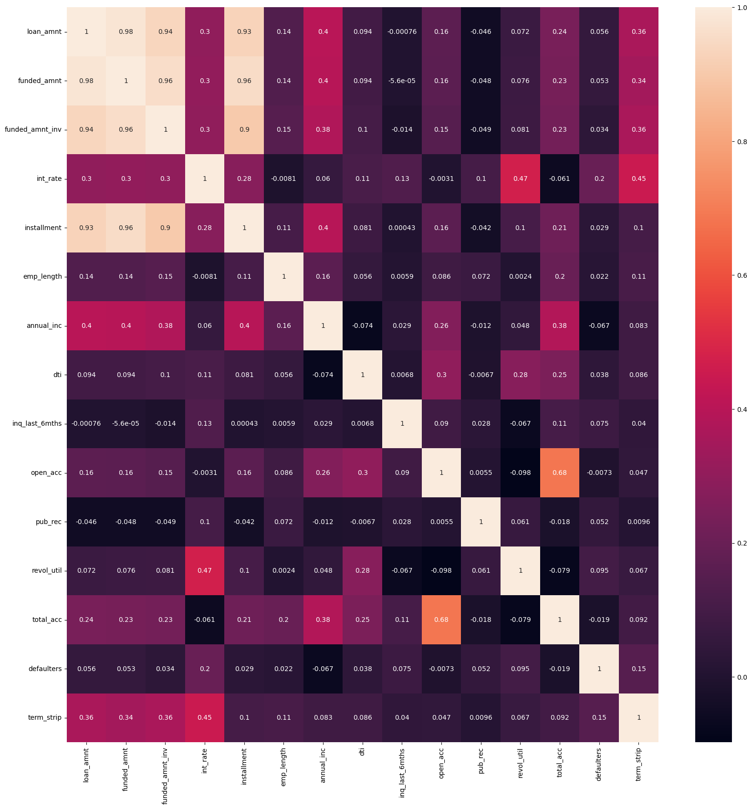
Correlations
Positive correlation trend observed between term and int_rate & revol_util

Slide 23
Recommendations
Shorter the period the number of borrowers are more. The borrower could be a defaulter if the term is lesser and also the term here may represent upcoming loan application related term or the processed loan term.
Majority of the loan borrowers income is not verified and they are prone to defaulting. Approximately around 20-25% of the borrowers income source was verified but not the income. There is a small percentage of risk that these borrowers can become defaulters. The verified borrowers are completely out of risk for defaulting process.
There are higher number of loan borrowers as part of grade A & B. Further, the loan borrowers decreases as the grade decreases.
Debt consolidation related loan borrowers are more.
As the interest increases the number of defaulters increase. The bank should consider interest rate minimal like the non defaulters while considering loan application processing and this should reduce the number of defaulters. Also, The revolving utilization rate is higher for defaulters based on the high usage of revolving credit.
As the annual income of the borrower is higher less chances of becoming defaulter. The defaulters are higher with less annual income.
The loan_amnt/funded_amnt/funded_amnt_inv all have a common trend as the loan_amnt/funded_amnt/funded_amnt_inv are high there are less defaulters. As the loan amount decreases, the defaulters high. It is also observed that, the loan_amnt/funded_amnt/funded_amnt_inv below 10000 has the highest defaulters and exceeding 10000 has the lowest trend.
There are more defaulters with loan interest rate in the range 5-15%. Higher the interest rate, the tendency to close/pay the loan is higher and also the defaulters are more when the salary range is below 50000. The defaulters are less with increased salary range of borrowers.
The defaulters trend is observed with every salary range of annual income but their purpose of loan categories are deviating for different range of annual_inc. Irrespective of the annual_inc and purpose of loan applied by borrower, the defaulting risk is high in every purpose and with every annual_inc range.
The defaulters are more with annual_inc greater than 50000 in loan borrowers categories like
home improvement/small
business/house/medical/credit card/wedding/debt
consolidation
The defaulters are more with annual_inc less than 50000 in loan borrowers categories like
Car/other/major
purpose/moving/vacation/education/renewable energy

Slide 24
Recommendations cont..
The borrowers with less loan term are having less defaulters with the loan amount below 10000. As the term is high, the defaulters are more with the increased loan amount trend. The defaulters are anyways high irrespective of term and also the loan amount.
The defaulters are identified in every category of the verification_status with verified/source verified/not verified. However, its good idea to reduce the loan_amnt as the defaulting risk is high irrespective of the verification_status
The defaulters are high in every home ownership category. However, The home ownership with mortgage and other categories are having very high defaulters trend. The own and rent home ownership categories are having comparatively less defaulters. Its better to consider the own and rent home categories with a lesser loan amount to reduce the defaulters risk. The mortgage home ownership is having higher loan amount and the high defaulters so, reducing the loan_amnt might reduce the risk of defaulters. As the interest goes high, the defaulters are high in every home ownership category
As the number of installments increases along with loan amount, there is a high risk of defaulters. With less installments and the less loan amount, we can see there is a positive correlation between the loan amount and installments.
Higher the annual income with lower loan amount, the defaulters are less as in the loan_amount below 20000 and the annual_inc around 100000 there are less defaulters. To reduce the defaulters risk, the loan amount approved for higher income borrowers can be little lower loan amount than the maximum suggested range today
The defaulters risk is low with reduced interest rate along with reduced loan amount. The interest exceeding 17.5 % and loan amount exceeding 15000 is not showing a great correlation and it indicates higher risk of defaulters.

Slide 25
THANK YOU

